Slide 1
Data Science with Python CS 498 (Special Topics in Computer Science) Chapter 1: Python
Dr. Malak Abdullah
Computer Science Department
Jordan University of Science and Technology

Slide 2
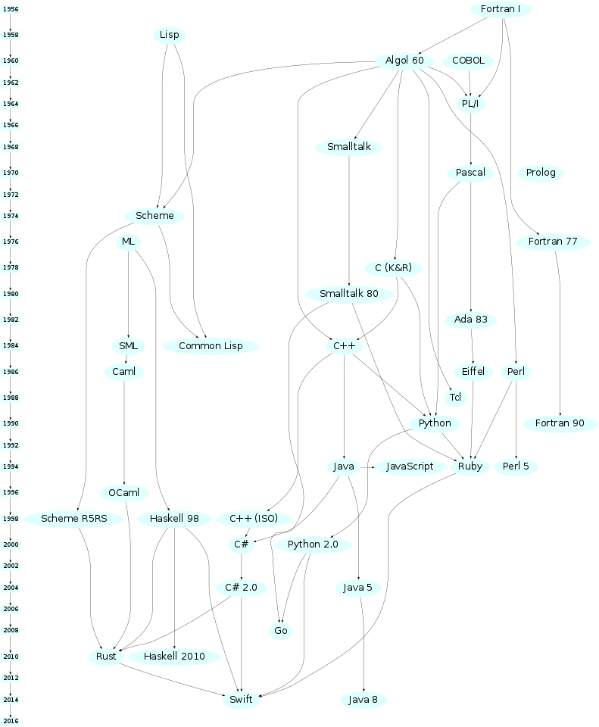

PyThon
“In December 1989, I was looking for a "hobby" programming project that would keep me occupied during the week around Christmas. My office ... would be closed, but I had a home computer, and not much else on my hands. I decided to write an interpreter for the new scripting language I had been thinking about lately: a descendant of ABC that would appeal to Unix/C hackers. I chose Python as a working title for the project, being in a slightly irreverent mood (and a big fan of Monty Python's Flying Circus).”
— Guido van Rossum

Slide 3
Good to Know
The big technology companies have each largely aligned themselves with different languages stacks.
Oracle and IBM are aligned with Java (Oracle actually owns Java).
Google are known for their use of Python (1997), a very versatile, dynamic and extensible language, although in reality they are also heavy users of C++ and Java. They have also created their own language called Go (2009).

Slide 4
Why Python?
Easy to learn and powerful programming language
It has efficient high-level data structures and a simple but effective approach to object-oriented programming.
Freely available in source or binary form for all major platforms from the Python Web site, https://www.python.org/
The Python interpreter is easily extended with new functions and data types implemented in C or C++ (or other languages callable from C).
Python is also suitable as an extension language for customizable applications.
Widely used (Google, NASA, Quora).

Slide 5
Python is interpreted language
When you run python program an interpreter will parse python program line by line basis, as compared to compiled languages like C or C++, where compiler first compiles the program and then start running.
Difference is that interpreted languages are little bit slow as compared to compiled languages.

Slide 6
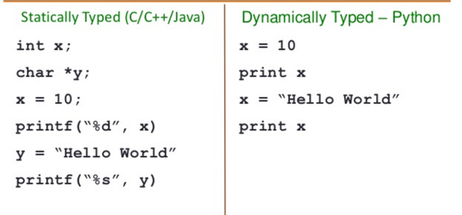
Python is Dynamically Typed
In python you don’t need to define variable data type ahead of time, python automatically guesses the data type of the variable based on the type of value it contains.

Slide 7
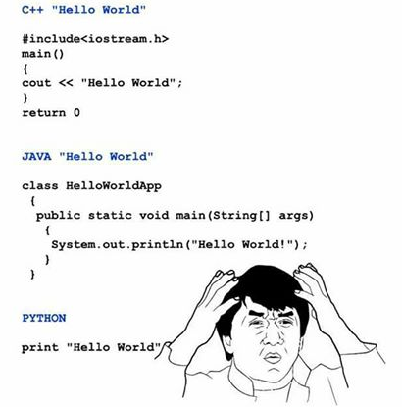
Write less code and do more!
Python codes are usually 1/3 or 1/5 of the java code. It means we can write less code in Python to achieve the same thing as in Java.

Slide 8
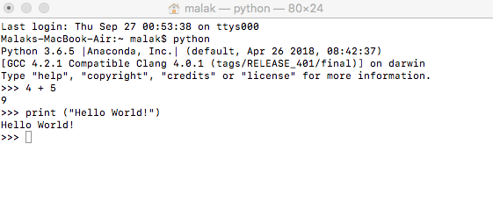
Typing code
There are many good options for saving and manipulating code
Sublime text (unlimited free trial available)
Notepad++
Xcode (Mac)
TextWrangler (Mac)
TextEdit (Mac)
Now there are multiple platforms for taking online courses for free
Coursera
Edx
Stanford Online
Khan Academy
Udacity

Slide 9
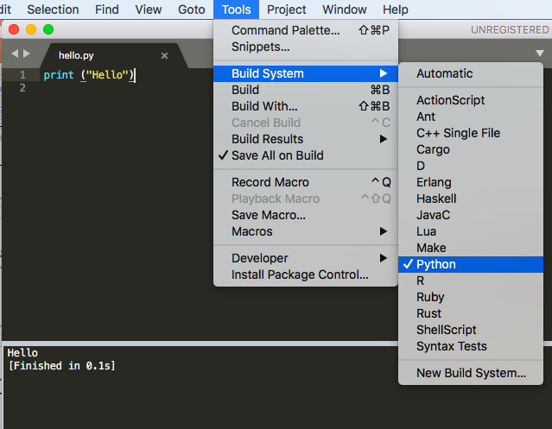
Save your file with .py
To download Python follow the instructions on the official website!
https://www.python.org/

Slide 10
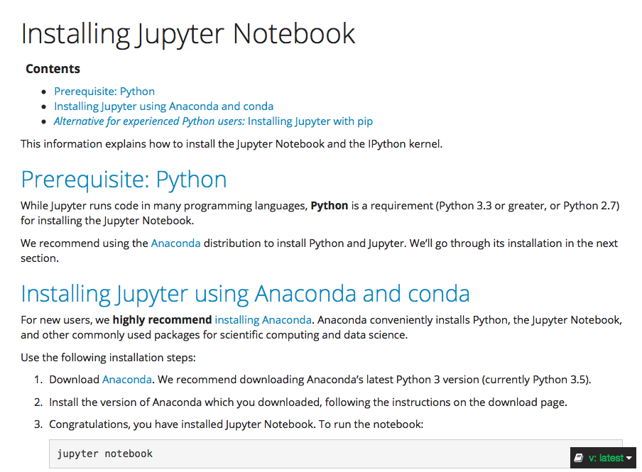
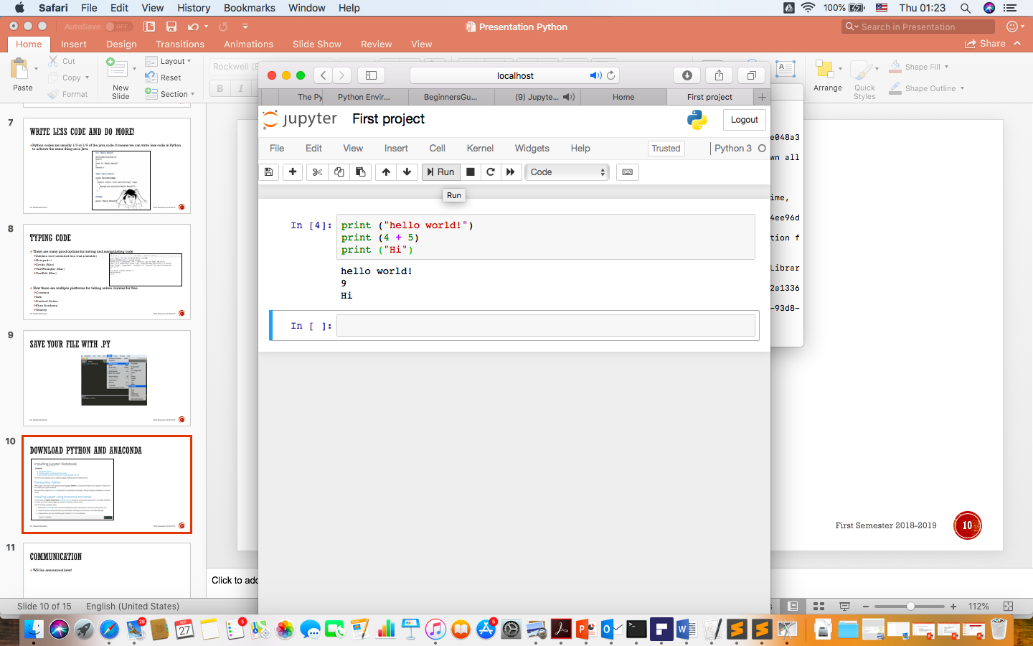
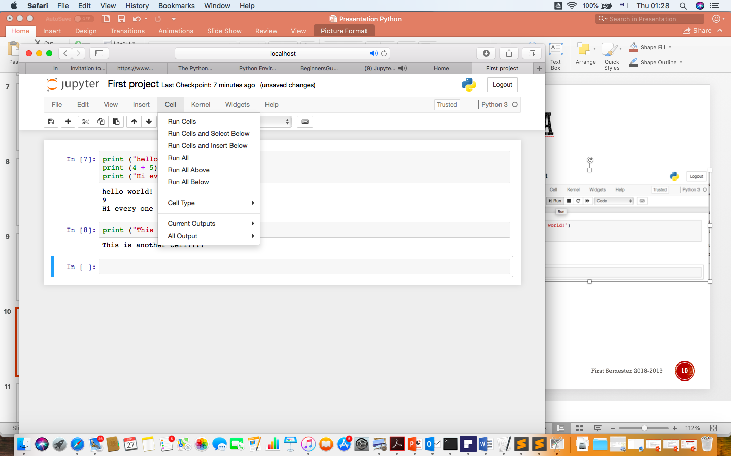
Download Python and ANAconda
I would strongly recommend this video:
https://www.youtube.com/watch?v=HW29067qVWk

Slide 11
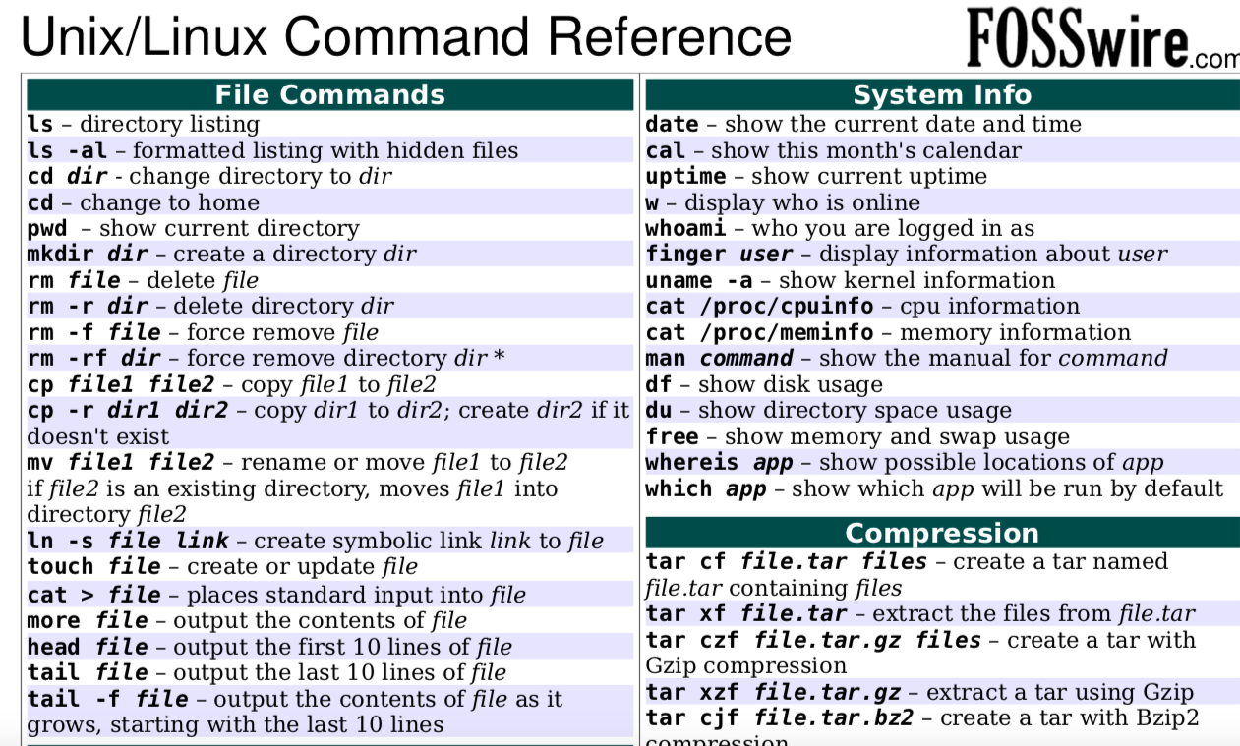
It is very important to learn:

Slide 12
Git and Github
https://git-scm.com/book/en/v2/Getting-Started-Installing-Git
https://github.com

Slide 13
What is Github?
“GitHub is a code hosting platform for version control and collaboration. It lets you and others work together on projects from anywhere”.
GitHub accounts can be public (free) or private (not free)
A repository is usually used to organize a single project, It contains folders and files, images, videos, spreadsheets, and data sets – anything your project needs.

Slide 14
Example of Repo
Master in a repository: The final version
Branch: To try out new ideas that don’t affect the master unless pull request is accepted. Any changes committed to branch reflects for you to keep track of different versions
Adding Commits: To Keep track (history) of user progress on a branch or master.
Forking a repository: creates a copy of Repo.
Submit a pull request to owner so that the owner can incorporate changes.

Slide 15
Assignment 1
Download Python and Jupyter Notebook
Write a python code to print your name, your id, and your favorite quote!
Save the project as .html and as .ipynb
Install git and create a GitHub account
Upload your first project as .html to e-learning
Upload your first project as .ipynb to your Github account
Share the link of your Github with me on e-learning
Deadline Wed 3/10/2018 at 23:55

Slide 16
On-line IDE for Python
https://www.tutorialspoint.com/execute_python_online.php
https://www.onlinegdb.com/online_python_compiler

Slide 17
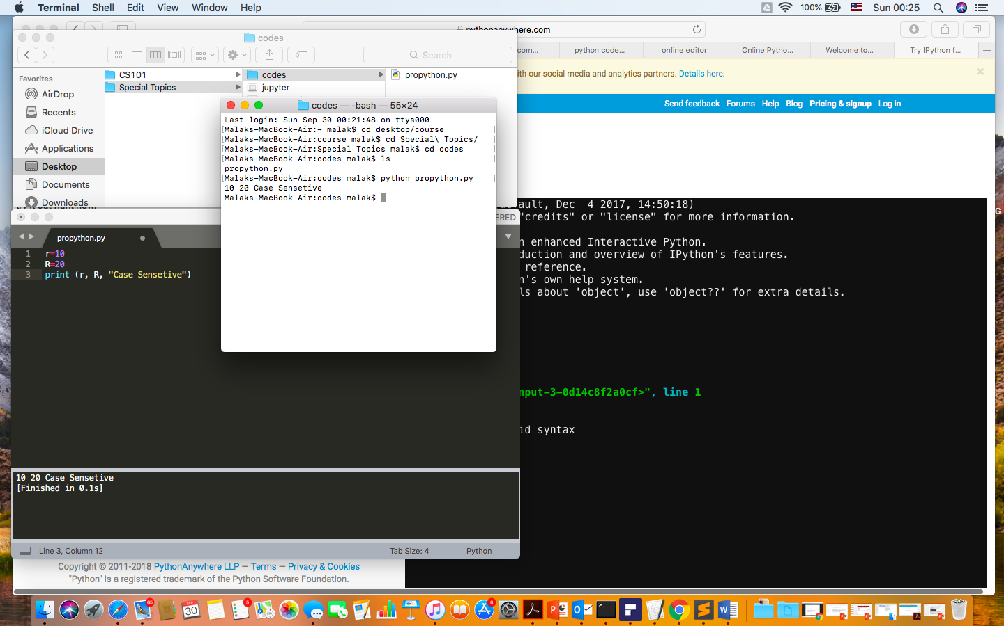
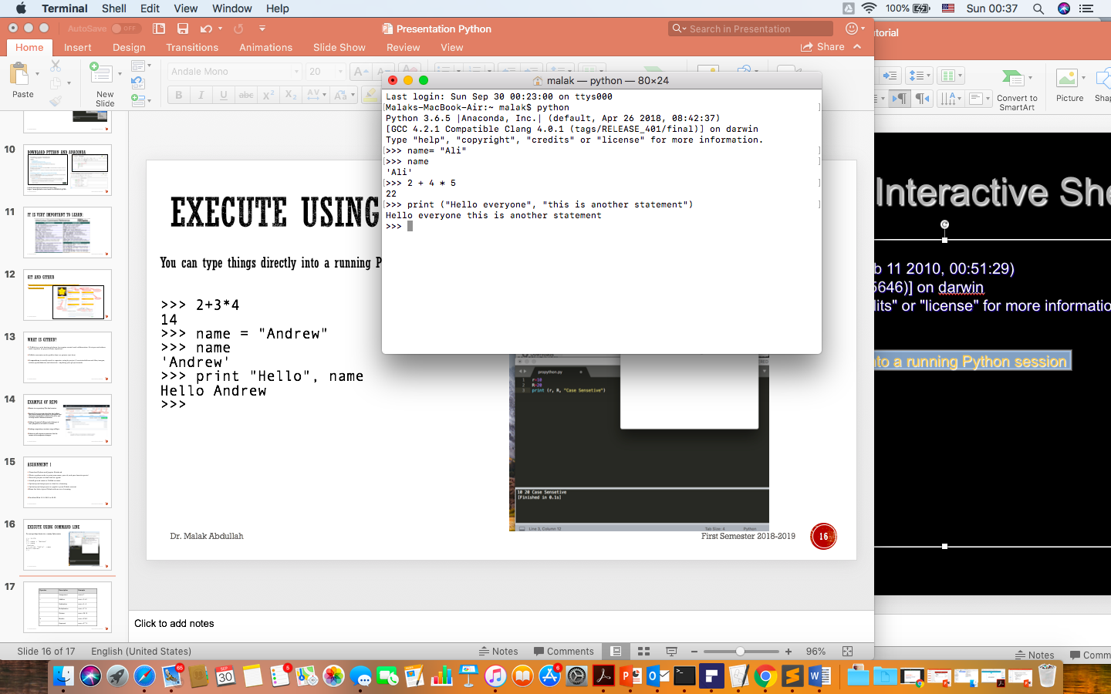
Execute using command line
You can type things directly into a running Python session

Slide 18
Python Indentation
Most of the programming languages like C, C++, Java use braces { } to define a block of code. Python uses indentation.
A code block (body of a function, loop etc.) starts with indentation and ends with the first unindented line. The amount of indentation is up to you, but it must be consistent throughout that block.
Generally four whitespaces are used for indentation and is preferred over tabs. Here is an example.
for i in range(1,11):
print(i)
if i == 5:
break
Incorrect indentation will result into IndentationError.

Slide 19
Comments
In Python, we use the hash (#) symbol to start writing a comment.
It extends up to the newline character. Comments are for programmers for better understanding of a program. Python Interpreter ignores comment.
#This is a comment
#print out Hello
print('Hello’)
If we have comments that extend multiple lines, one way of doing it is to use hash (#) in the beginning of each line.
Another way of doing this is to use triple quotes, either ’ ‘ ' or ” ” ".
These triple quotes are generally used for multi-line strings. But they can be used as multi-line comment as well.
"""This is also
a perfect example
of multi-line comments"""

Slide 20
Expressions
expression: A data value or set of operations to compute a value.
Examples: 1 + 4 * 3
42
Arithmetic operators we will use:
+ - * / addition, subtraction, multiplication, division
% modulus, a.k.a. remainder
** exponentiation
precedence: Order in which operations are computed.
* / % ** have a higher precedence than + - 1 + 3 * 4 is 13
Parentheses can be used to force a certain order of evaluation. (1 + 3) * 4 is 16
Operator | Description | Example
= | Assignment | num = 7
+ | Addition | num = 2 + 2
- | Subtraction | num = 6 - 4
* | Multiplication | num = 5 * 4
/ | Division | num = 25 / 5
% | Modulo | num = 8 % 3
** | Exponent | num = 9 ** 2

Slide 21
Integer and Real numbers
When we divide integers with / , the quotient is also an integer.
35 / 5 is 7
84 / 10 is 8
156 / 100 is 1
The % operator computes the remainder from a division of integers.
The operators + - * / % ** ( ) all work for real numbers.
The / produces an exact answer: 15.0 / 2.0 is 7.5
The same rules of precedence also apply to real numbers: Evaluate ( ) before * / % before + -
When integers and reals are mixed, the result is a real number.
Example: 1 / 2.0 is 0.5
The conversion occurs on a per-operator basis
7 / 3 * 1.2 + 3 / 2
2 * 1.2 + 3 / 2
2.4 + 3 / 2
2.4 + 1
3.4

Slide 22
Math commands
Constant | Description
e | 2.7182818...
pi | 3.1415926...
Python has useful commands for performing calculations.
Command name | Description
abs(value) | absolute value
ceil(value) | rounds up
cos(value) | cosine, in radians
floor(value) | rounds down
log(value) | logarithm, base e
log10(value) | logarithm, base 10
max(value1, value2) | larger of two values
min(value1, value2) | smaller of two values
round(value) | nearest whole number
sin(value) | sine, in radians
sqrt(value) | square root
To use many of these commands, you must write the following at the top of your Python program:
from math import *

Slide 23
Variables
variable: A named piece of memory that can store a value.
Usage:
Compute an expression's result,
store that result into a variable,
and use that variable later in the program.
assignment statement: Stores a value into a variable.
Syntax:
name = value
Examples: x = 5 gpa = 3.14
x 5 gpa 3.14
A variable that has been given a value can be used in expressions.
x + 4 is 9
Exercise: Evaluate the quadratic equation for a given a, b, and c.

Slide 24
print
print : Produces text output on the console.
Syntax:
print ("Message”)
print (Expression)
Prints the given text message or expression value on the console, and moves the cursor down to the next line.
print (Item1, Item2, ..., ItemN)
Prints several messages and/or expressions on the same line.
Examples:
print "Hello, world!"
age = 45
print "You have", 65 - age, "years until retirement"
Output:
Hello, world!
You have 20 years until retirement

Slide 25
input
input : Reads a number from user input.
You can assign (store) the result of input into a variable.
Example:
age = input("How old are you? ")
print "Your age is", age
print "You have", 65 - age, "years until retirement"
Output:
How old are you? 53
Your age is 53
You have 12 years until retirement
Exercise: Write a Python program that prompts the user for his/her amount of money, then reports how many Nintendo Wiis the person can afford, and how much more money he/she will need to afford an additional Wii.

Slide 26
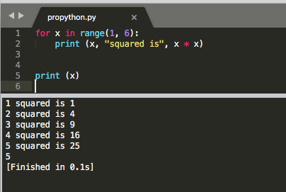
The for loop
for loop: Repeats a set of statements over a group of values.
Syntax:
for variableName in groupOfValues:
statements
We indent the statements to be repeated with tabs or spaces.
variableName gives a name to each value, so you can refer to it in the statements.
groupOfValues can be a range of integers, specified with the range function.
Example:
for x in range(1, 6):
print x, "squared is", x * x //python 2.6
Output:
1 squared is 1
2 squared is 4
3 squared is 9
4 squared is 16
5 squared is 25

Slide 27
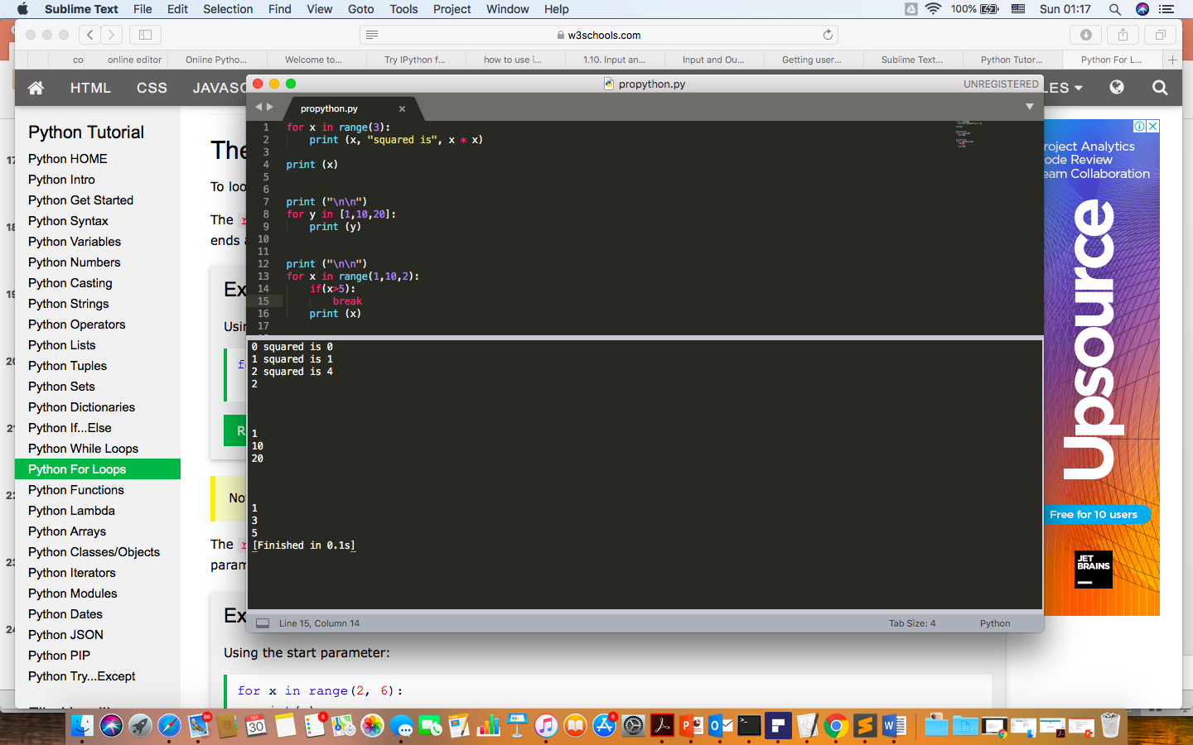
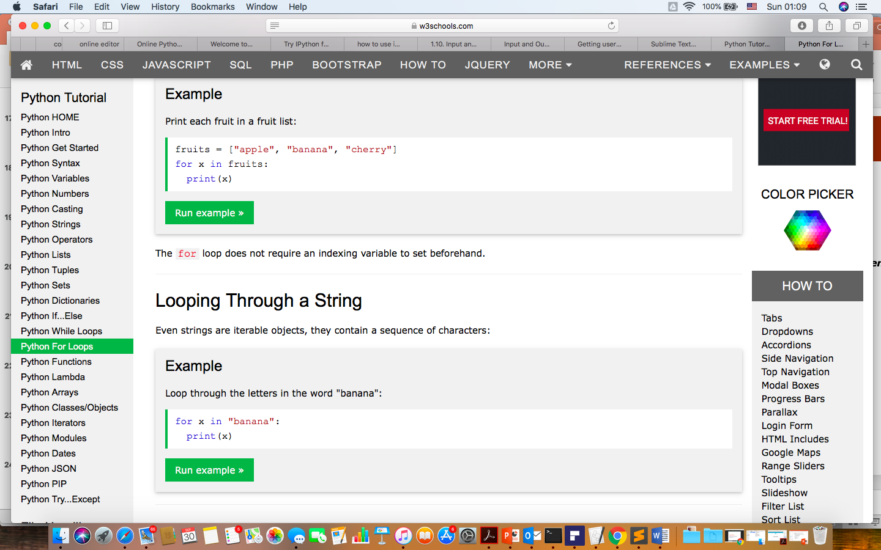
For loops

Slide 28
range
The range function specifies a range of integers:
range(start, stop) - the integers between start (inclusive)
and stop (exclusive)
It can also accept a third value specifying the change between values.
range(start, stop, step) - the integers between start (inclusive)
and stop (exclusive) by step
Example:
for x in range(5, 0, -1):
print x
print ”Hello!"
Output:
5
4
3
2
1
Hello!

Slide 29
Cumulative loops
Some loops incrementally compute a value that is initialized outside the loop. This is sometimes called a cumulative sum.
sum = 0
for i in range(1, 11):
sum = sum + (i * i)
print "sum of first 10 squares is", sum
Output:
sum of first 10 squares is 385
Exercise: Write a Python program that computes the factorial of an integer.

Slide 30
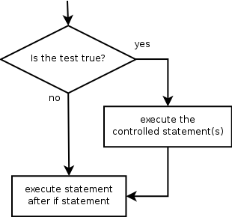
if
if statement: Executes a group of statements only if a certain condition is true. Otherwise, the statements are skipped.
Syntax:
if condition:
statements
Example:
gpa = 3.4
if gpa > 2.0:
print "Your application is accepted."

Slide 31
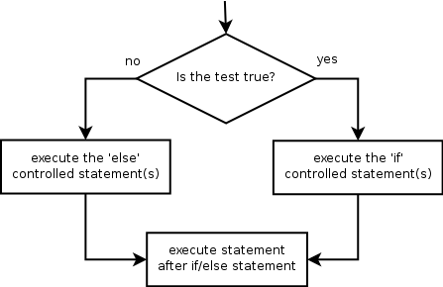
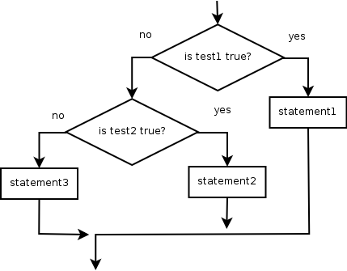
if/else
if/else statement: Executes one block of statements if a certain condition is True, and a second block of statements if it is False.
Syntax:
if condition:
statements
else:
statements
Example:
gpa = 1.4
if gpa > 2.0:
print "Welcome to JUST University!"
else:
print "Your application is denied."
Multiple conditions can be chained with elif ("else if"):
if condition:
statements
elif condition:
statements
else:
statements

Slide 32
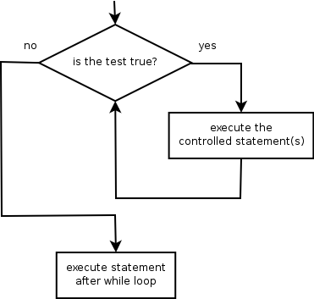
while
while loop: Executes a group of statements as long as a condition is True.
good for indefinite loops (repeat an unknown number of times)
Syntax:
while condition:
statements
Example:
number = 1
while number < 200:
print number,
number = number * 2
Output:
1 2 4 8 16 32 64 128

Slide 33
Logic
Many logical expressions use relational operators:
Logical expressions can be combined with logical operators:
Exercise: Write code to display and count the factors of a number.
Operator | Meaning | Example | Result
== | equals | 1 + 1 == 2 | True
!= | does not equal | 3.2 != 2.5 | True
< | less than | 10 < 5 | False
> | greater than | 10 > 5 | True
<= | less than or equal to | 126 <= 100 | False
>= | greater than or equal to | 5.0 >= 5.0 | True
Operator | Example | Result
and | 9 != 6 and 2 < 3 | True
or | 2 == 3 or -1 < 5 | True
not | not 7 > 0 | False

Slide 34
Strings
string: A sequence of text characters in a program.
Strings start and end with quotation mark " or apostrophe ' characters.
Examples: "hello" "This is a string" "This, too, is a string. It can be very long!"
A string may not span across multiple lines or contain a " character. "This is not a legal String."
"This is not a "legal" String either."
A string can represent characters by preceding them with a backslash.
\t tab character
\n new line character
\" quotation mark character
\\ backslash character
Example: "Hello\tthere\nHow are you?"

Slide 35
Indexes
Characters in a string are numbered with indexes starting at 0:
Example:
name = "P. Diddy"
Accessing an individual character of a string:
variableName [ index ]
Example:
print name, "starts with", name[0]
Output:
P. Diddy starts with P
index | 0 | 1 | 2 | 3 | 4 | 5 | 6 | 7
character | P | . |  | D | i | d | d | y

Slide 36
String properties
len(string) - number of characters in a string (including spaces)
str.lower(string) - lowercase version of a string
str.upper(string) - uppercase version of a string
Example:
name = "Martin Douglas Stepp"
length = len(name)
big_name = str.upper(name)
print big_name, "has", length, "characters"
Output:
MARTIN DOUGLAS STEPP has 20 characters

Slide 37
List
A compound data type:
[0]
[2.3, 4.5]
[5, "Hello", "there", 9.8]
[]
Use len() to get the length of a list
>>> names = [“Ben", “Chen", “Yaqin"]
>>> len(names)
3

Slide 38
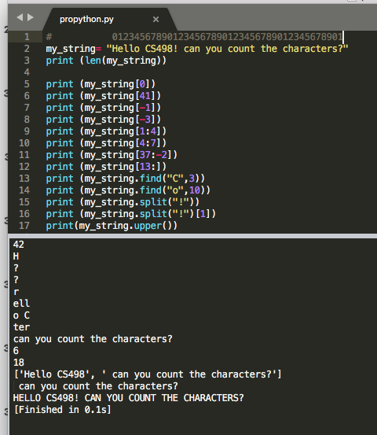
More about String

Slide 39
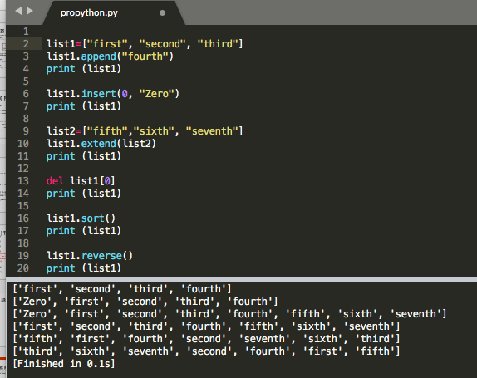
Lists are mutable - some useful methods

Slide 40
The key differences between Python 2.7.x and Python 3.x with examples
http://sebastianraschka.com/Articles/2014_python_2_3_key_diff.html

Slide 41
Modules
Certain features of Python are not loaded by default
In order to use these features, you’ll need to import the modules that contain them.
E.g.
import matplotlib.pyplot as plt
import numpy as np

Slide 42
Division
f = 7 / 2
# in python 2, f will be 3, unless “from __future__ import division”
f = 7 / 2 # in python 3 f = 3.5
f = 7 // 2 # f = 3 in both python 2 and 3
f = 7 / 2. # f = 3.5 in both python 2 and 3
f = 7 / float(2) # f is 3.5 in both python 2 and 3
f = int(7 / 2) # f is 3 in both python 2 and 3

Slide 43
More about List
Get the i-th element of a list
x = [i for i in range(10)] # is the list [0, 1, ..., 9]
zero = x[0] # equals 0, lists are 0-indexed
one = x[1] # equals 1
nine = x[-1] # equals 9, 'Pythonic' for last element
eight = x[-2] # equals 8, 'Pythonic' for next-to-last element
one_to_four = x[1:5] # [1, 2, 3, 4]
first_three = x[:3] # [0, 1, 2]
last_three = x[-3:] # [7, 8, 9]
three_to_end = x[3:] # [3, 4, ..., 9]
without_first_and_last = x[1:-1] # [1, 2, ..., 8]
copy_of_x = x[:] # [0, 1, 2, ..., 9]
another_copy_of_x = x[:3] + x[3:] # [0, 1, 2, ..., 9]

Slide 44
List - 2
1 in [1, 2, 3] # True
0 in [1, 2, 3] # False
x = [1, 2, 3]
y = [4, 5, 6]
x.extend(y) # x is now [1,2,3,4,5,6]
x = [1, 2, 3]
y = [4, 5, 6]
z = x + y # z is [1,2,3,4,5,6]; x is unchanged.
x, y = [1, 2] # x is 1 and y is 2
[x, y] = 1, 2 # same as above
x, y = [1, 2] # same as above
x, y = 1, 2 # same as above
_, y = [1, 2] # y is 2, didn't care about the first element

Slide 45
For loop
>>> a = ['Mary', 'had', 'a', 'little', 'lamb']
>>> for i in range(len(a)):
... print(i, a[i])
...
0 Mary
1 had
2 a
3 little
4 lamb

Slide 46
Ref to lists
a = [0, 1, 2, 3, 4]
b = a
c = a[:]
a == b
Out[129]: True
a is b
Out[130]: True
a == c
Out[132]: True
a is c
Out[133]: False
What are the expected output for the following code?
a = list(range(10))
b = a
b[0] = 100
print(a)
a = list(range(10))
b = a[:]
b[0] = 100
print(a)
[100, 1, 2, 3, 4, 5, 6, 7, 8, 9]
[0, 1, 2, 3, 4, 5, 6, 7, 8, 9]

Slide 47
tuples
Similar to lists, but are immutable
a_tuple = (0, 1, 2, 3, 4)
Other_tuple = 3, 4
Another_tuple = tuple([0, 1, 2, 3, 4])
Hetergeneous_tuple = (‘john’, 1.1, [1, 2])
Can be sliced, concatenated, or repeated
a_tuple[2:4] # will print (2, 3)
Cannot be modified
a_tuple[2] = 5
Note: tuple is defined by comma, not parentheses, which is only used for convenience and grouping elements. So a = (1) is not a tuple, but a = (1,) is.
TypeError: 'tuple' object does not support item assignment

Slide 48
Tuples - 2
Useful for returning multiple values from functions
Tuples and lists can also be used for multiple assignments
def sum_and_product(x, y):
return (x + y),(x * y)
sp = sum_and_product(2, 3) # equals (5, 6)
s, p = sum_and_product(5, 10) # s is 15, p is 50
x, y = 1, 2
[x, y] = [1, 2]
(x, y) = (1, 2)
x, y = y, x

Slide 49
Good To Know!!
a = [1, 2, 3, 4, 5, 6]
my_tuple=(a,)
my_tuple[0]=a #### ERROR
a = [1, 2, 3, 4, 5, 6]
my_tuple=(a)
my_tuple[0]=a #### No ERROR
a = [1, 2, 3, 4, 5, 6]
my_tuple=(a,)
my_tuple[0]=5 #### ERROR
a = [1, 2, 3, 4, 5, 6]
my_tuple=(a,)
my_tuple[0][0]=5 #### No ERROR

Slide 50
Dictionaries
A dictionary associates values with unique keys
empty_dict = {} # Pythonic
empty_dict2 = dict() # less Pythonic
grades = { "Joel" : 80, "Tim" : 95 } # dictionary literal
Access/modify value with key
joels_grade = grades["Joel"] # equals 80
grades["Tim"] = 99 # replaces the old value
grades["Kate"] = 100 # adds a third entry
num_students = len(grades) # equals 3
try:
kates_grade = grades["Kate"]
except KeyError:
print "no grade for Kate!"

Slide 51
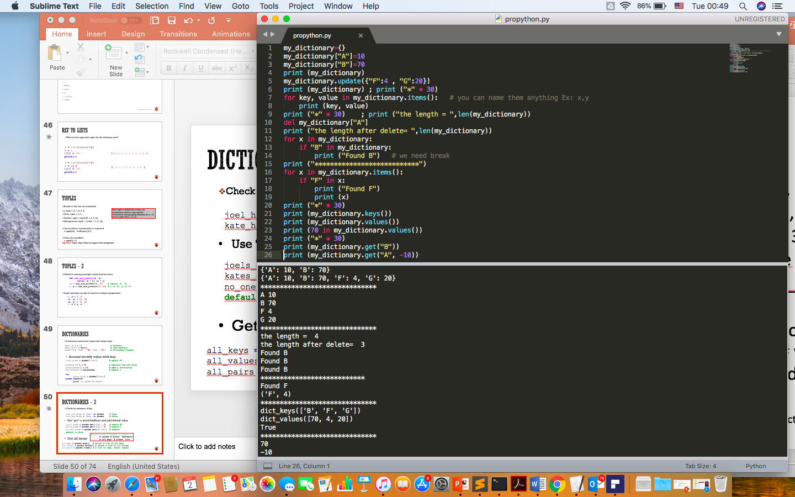

Slide 52
Dictionaries - 2
Check for existence of key
joel_has_grade = "Joel" in grades # True
kate_has_grade = "Kate" in grades # False
Use “get” to avoid keyError and add default value
joels_grade = grades.get("Joel", 0) # equals 80
kates_grade = grades.get("Kate", 0) # equals 0
no_ones_grade = grades.get("No One") # default default is None
In python3, The following will not return lists but iterable objects
#Which of the following is faster?
'Joel' in grades # faster. Hashtable
'Joel' in all_keys # slower. List.
Get all items
all_keys = grades.keys() # return a list of all keys
all_values = grades.values() # return a list of all values
all_pairs = grades.items() # a list of (key, value) tuples

Slide 53
Good to know!
a = [0, 0, 0, 1]
any(a)
Out[135]: True
all(a)
Out[136]: False

Slide 54
Exceptions
try:
print 0 / 0
except ZeroDivisionError:
print ("cannot divide by zero")
https://docs.python.org/3/tutorial/errors.html

Slide 55
Functions - 1
Functions are defined using def
def double(x):
"""this is where you put an optional docstring
that explains what the function does.
for example, this function multiplies its input by 2"""
return x * 2
You can call a function after it is defined
z = double(10) # z is 20
You can give default values to parameters
def my_print(message="my default message"):
print (message)
my_print("hello") # prints 'hello'
my_print() # prints 'my default message‘

Slide 56
Functions - 2
Sometimes it is useful to specify arguments by name
def subtract(a=0, b=0):
return a – b
subtract(10, 5) # returns 5
subtract(0, 5) # returns -5
subtract(b = 5) # same as above
subtract(b = 5, a = 0) # same as above

Slide 57
Functions - 3
Functions are objects too
In [12]: def double(x): return x * 2
...: DD = double;
...: DD(2)
...:
Out[12]: 4
In [16]: def apply_to_one(f):
...: return f(1)
...: x=apply_to_one(DD)
...: x
...:
Out[16]: 2

Slide 58
Functions – lambda expression
Small anonymous functions can be created with the lambda keyword.
A lambda function can take any number of arguments, but can only have one expression.
x = lambda a : a + 10
print(x(5))
x = lambda a, b, c : a * b - c
print(x(5, 6, 2))
def myfunc(n):
return lambda a : a * n
mydoubler = myfunc(2)
mytripler = myfunc(3)
print(mydoubler(11))
print(mytripler(11))
The power of lambda is better shown when you use them as an anonymous function inside another function.

Slide 59
lambda expression - 2
pairs = [(2, 'two'), (3, 'three'), (1, 'one'), (4, 'four')]
pairs.sort(key = lambda pair: pair[0])
print (pairs)
Out[22]: [(1, 'one'), (2, 'two'), (3, 'three'), (4, 'four')]
def getKey(pair): return pair[0]
pairs.sort(key=getKey)
print (pairs)
Out[107]: [(1, 'one'), (2, 'two'), (3, 'three'), (4, 'four')

Slide 60
List comprehension
A very convenient way to create a new list
squares = [x * x for x in range(5)]
print (squares)
Out[52]: [0, 1, 4, 9, 16]
squares=[0,0,0,0,0]
for x in range(5):
squares[x] = x * x
print (squares)
Out[64]: [0, 1, 4, 9, 16]

Slide 61
List comprehension - 2
Can also be used to filter list
In [65]: even_numbers = [x for x in range(5) if x % 2 == 0]
In [66]: even_numbers
Out[66]: [0, 2, 4]
In [68]: even_numbers = []
In [69]: for x in range(5):
...: if x % 2 == 0:
...: even_numbers.append(x)
...: even_numbers
Out[69]: [0, 2, 4]

Slide 62
List comprehension - 3
More complex examples:
# create 100 pairs (0,0) (0,1) ... (9,8), (9,9)
pairs = [(x, y)
for x in range(10)
for y in range(10)]
# only pairs with x < y,
# range(lo, hi) equals
# [lo, lo + 1, ..., hi - 1]
increasing_pairs = [(x, y)
for x in range(10)
for y in range(x + 1, 10)]
[(0, 1), (0, 2), (0, 3), (0, 4), (0, 5), (0, 6), (0, 7), (0, 8), (0, 9), (1, 2), (1, 3) …etc

Slide 63
Functools: map, reduce, filter
Convenient tools in python to apply function to sequences of data
def double(x): return 2*x
b=range(5)
list(map(double, b))
Out[203]: [0, 2, 4, 6, 8]
def double(x): return 2*x
print ([double(i) for i in range(5)])
Out[205]: [0, 2, 4, 6, 8]
In [204]: double(b)
Traceback (most recent call last):
TypeError: unsupported operand type(s) for *: 'int' and 'range'

Slide 64
map(lambda x : x*2, [1, 2, 3, 4]) #Output [2, 4, 6, 8]
map(lambda x, y: x + y, list_a, list_b) # Output: [11, 22, 33]
map_output = map(lambda x: x*2, [1, 2, 3, 4])
print(map_output) # Output: map object: <map object at 0x04D6BAB0>
list_map_output = list(map_output)
print(list_map_output) # Output: [2, 4, 6, 8]

Slide 65
Functools: map, reduce, filter
a = [1, 2, 3, 4, 5, 6]
print list(filter(lambda x : x % 2 == 0, a)) # Output: [2, 4, 6]
def is_even(x): return x%2==0
a=[0, 1, 2, 3]
list(filter(is_even, a))
Out[208]: [0, 2]
In [209]: [a[i] for i in a if is_even(i)]
Out[209]: [0, 2]

Slide 66
Functools: map, reduce, filter
In [216]: from functools import reduce
In [217]: reduce(lambda x, y: x+y, range(10))
Out[217]: 45
In [220]: reduce(lambda x, y: x*y, [1, 2, 3, 4])
Out[220]: 24

Slide 67
zip
Useful to combined multiple lists into a list of tuples
In [238]: list(zip(['a', 'b', 'c'], [1, 2, 3], ['A', 'B', 'C']))
Out[238]: [('a', 1, 'A'), ('b', 2, 'B'), ('c', 3, 'C')]
In [245]: names = ['James', 'Tom', 'Mary']
...: grades = [100, 90, 95]
...: list(zip(names, grades))
...:
Out[245]: [('James', 100), ('Tom', 90), ('Mary', 95)]

Slide 68
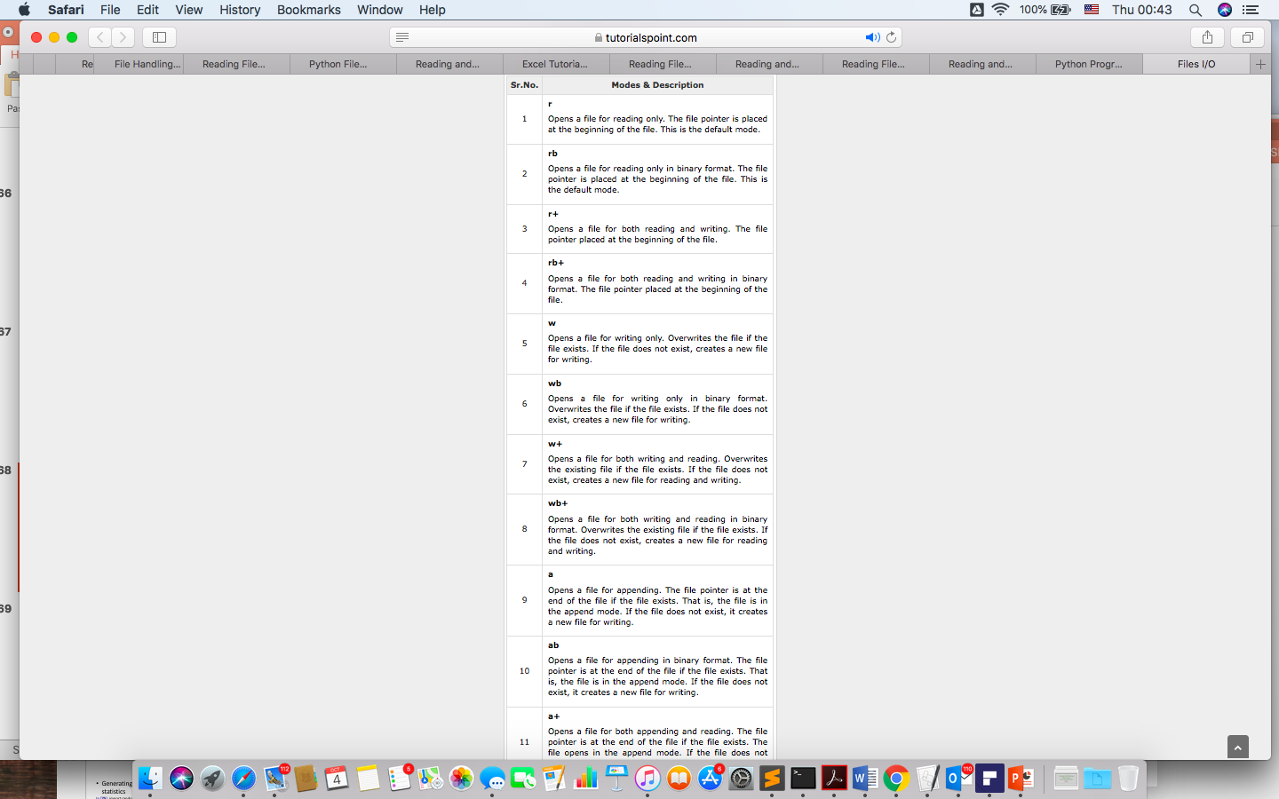
Input output files
file object = open(file_name [, access_mode])
access_mode − The access_mode determines the mode in which the file has to be opened, i.e., read, write, append, etc. A complete list of possible values is given below in the table. This is optional parameter and the default file access mode is read (r).

Slide 69
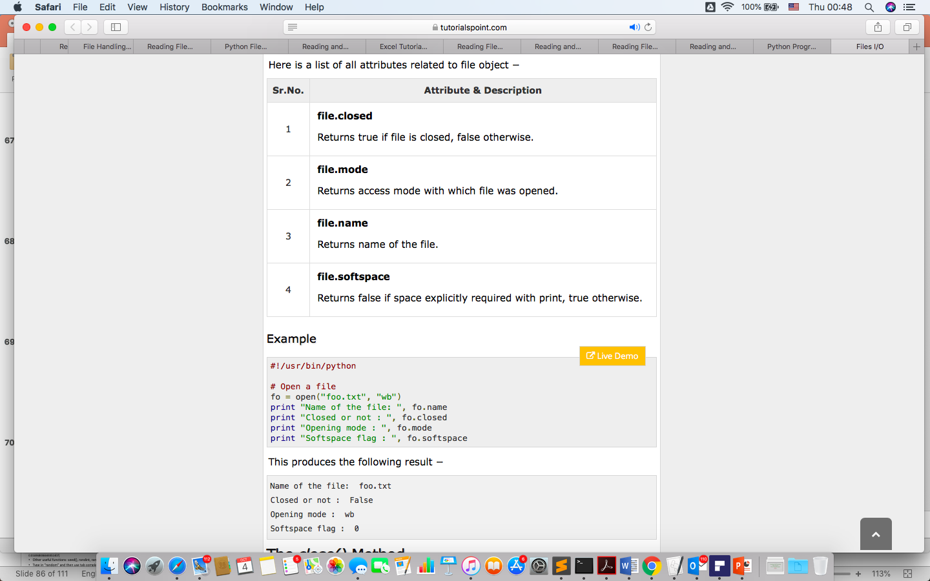

Slide 70
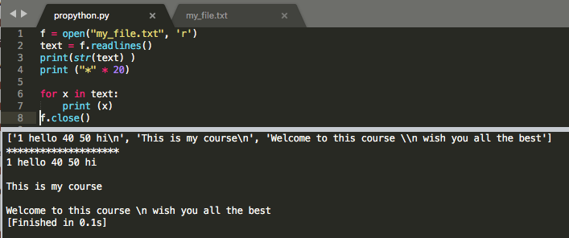
read(): It reads the entire file and returns it contents in the form of a string
readline(): It reads the first line of the file i.e till a newline character or an EOF in case of a file having a single line and returns a string
readlines(): It reads the entire file line by line and returns a list of line strings
f = open("my_file2.txt", 'w')
f.write("Hello Everyone!")
1 hello 40 50 hi
This is my course
Welcome to this course \n wish you all the best

Slide 71
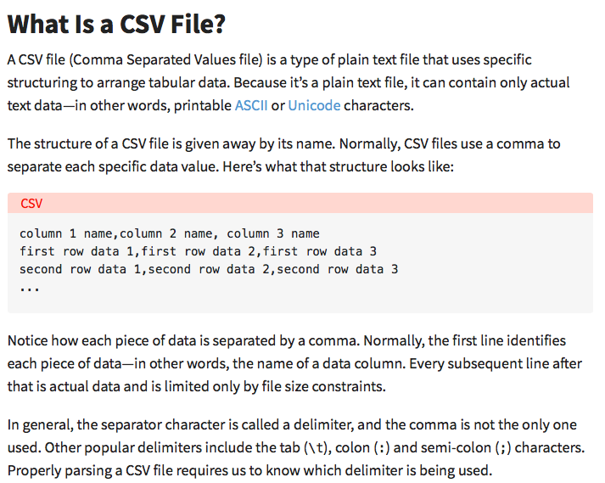
Notice how each piece of data is separated by a comma.

Slide 72
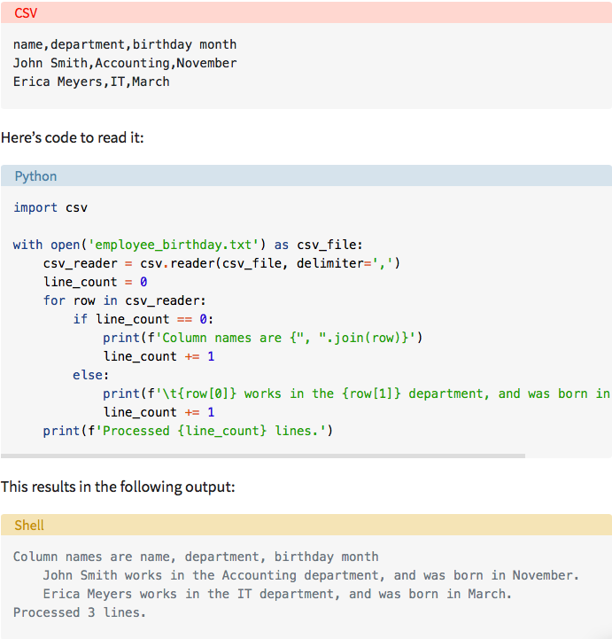

Slide 73
Quiz on Tuesday ☺

